Slide 1
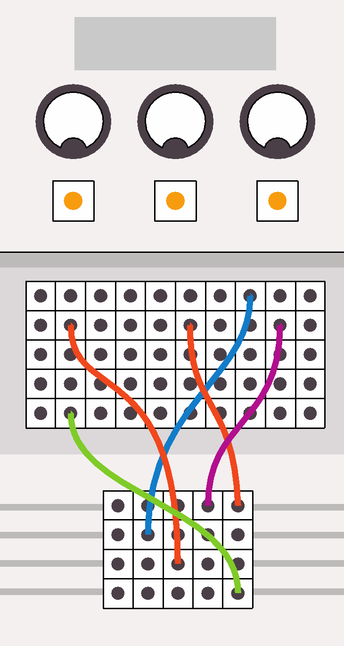
Computing:
past, present and future
Lesson 6: The future of computing

Slide 2
Objectives
In this lesson, you will:
learn about the future of computing
demonstrate your word-processing or your presentation skills.

Slide 3
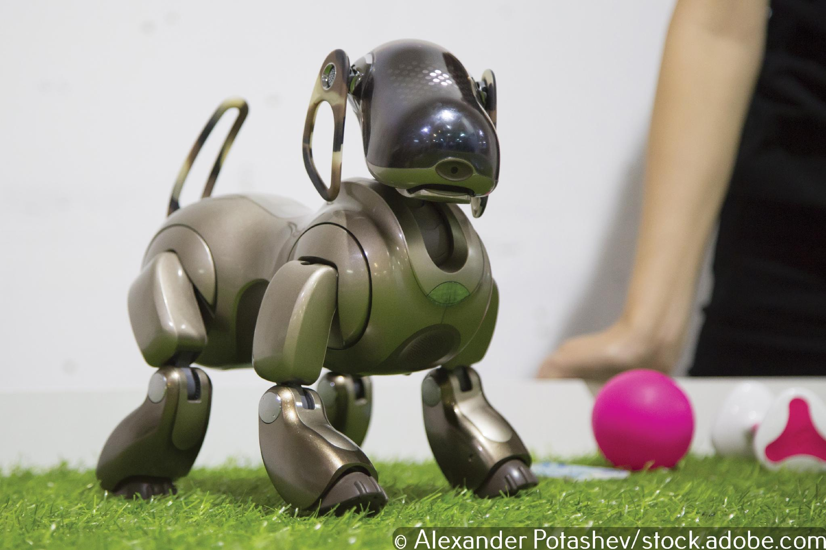
Will we be using these technologies in the future?
Will robot dogs provide companionship?

Slide 4
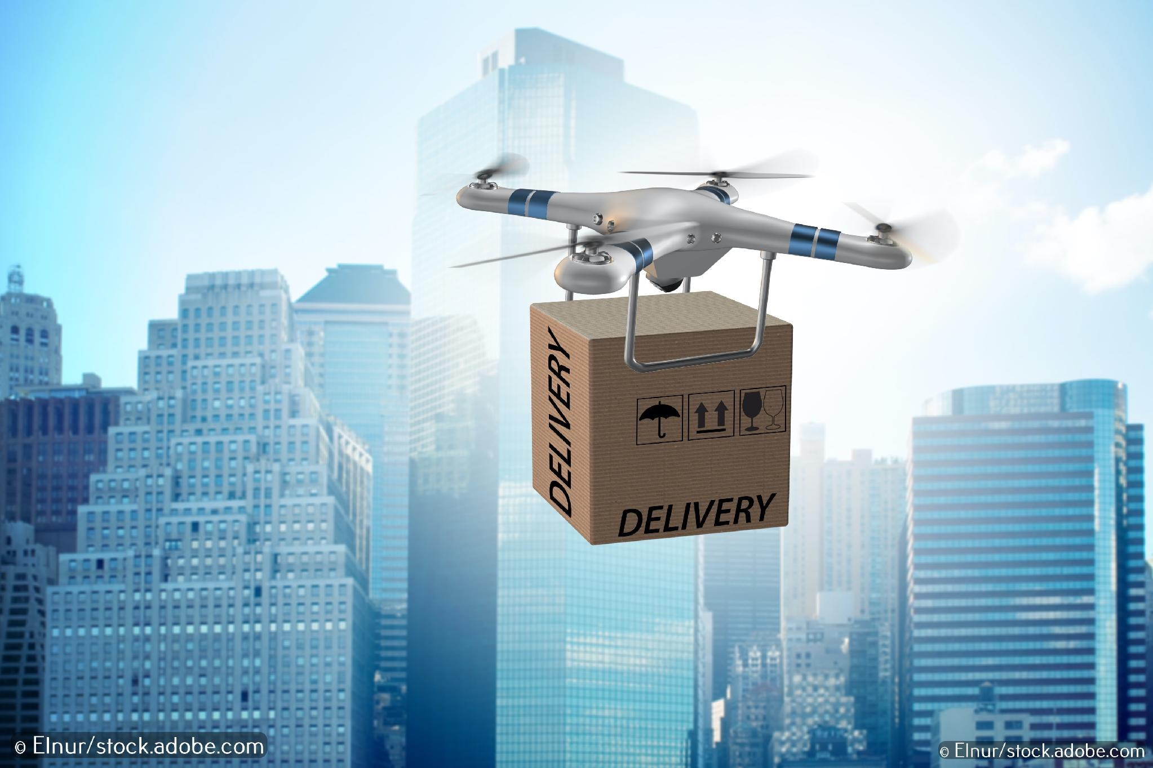
Will we be using these technologies in the future?
Will drones deliver small packages to our homes?

Slide 5
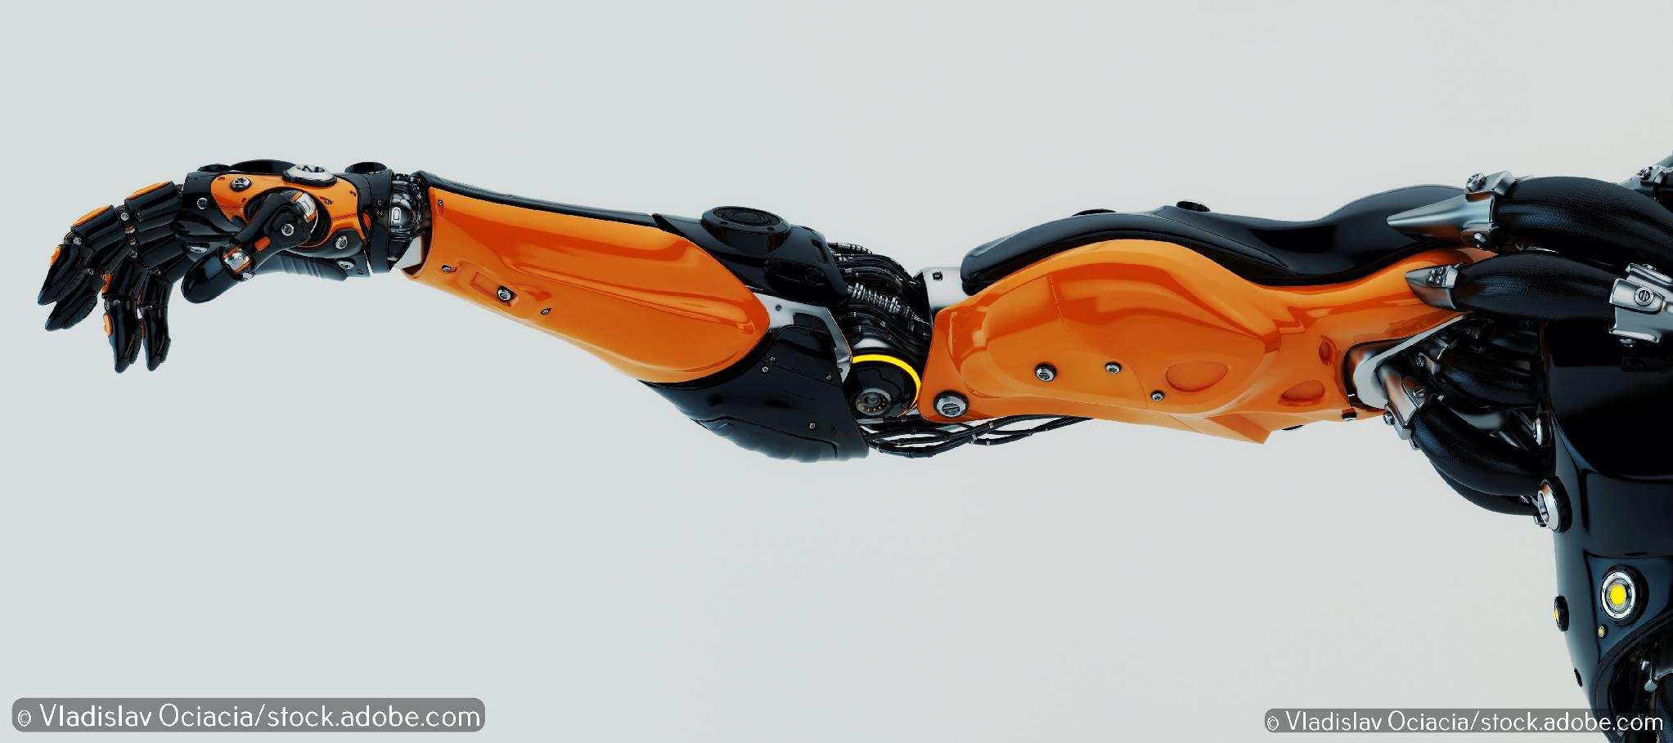
Will we be using these technologies in the future?
Will we have brain chips implanted that will be able to control computers, including our mobile phones and artificial limbs, with no interaction?

Slide 6
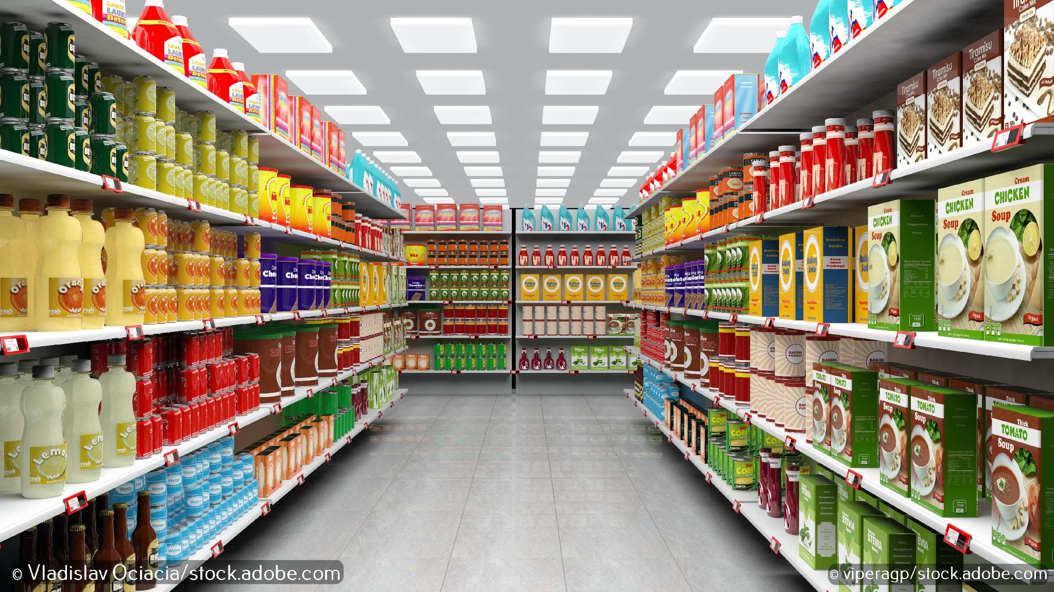
Will we be using these technologies in the future?
Will we be able to select an item in a shop and walk straight out with it, paying without queuing or interacting with a cashier?

Slide 7
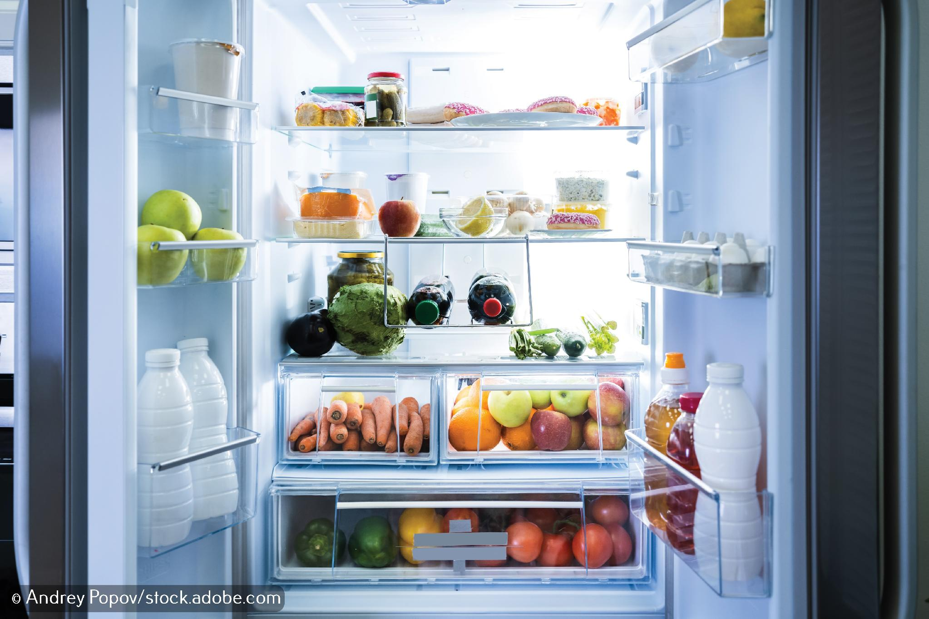
Will we be using these technologies in the future?
Will your fridge be able to tell you when food inside it is about to go off?

Slide 8
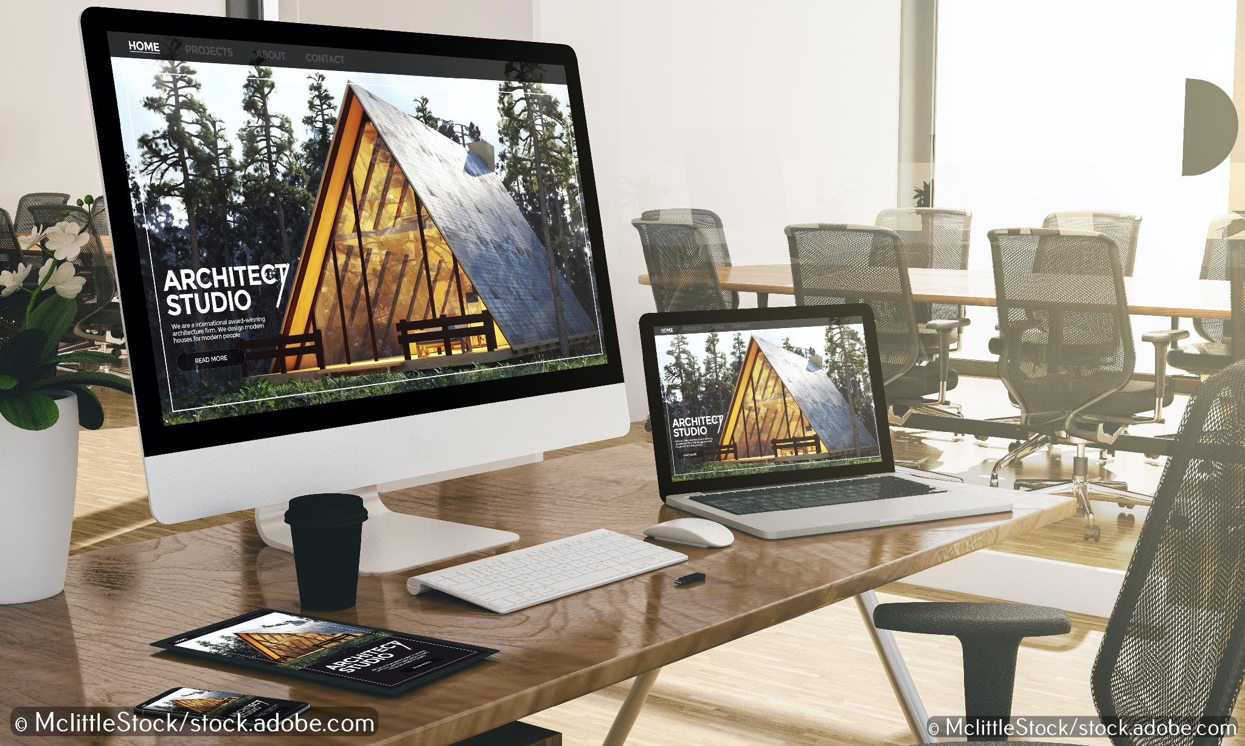
Predicting the future isn’t as easy as it might seem
Here are some of the predictions made about the computer:
‘I think there is a world market for maybe five computers.’
Thomas Watson, President of IBM, 1943
‘There is no reason anyone would want a computer in their home.’
Ken Olsen, founder of Digital Equipment Corporation, 1977

Slide 9
The qualities of a well-designed report
The report has a title. It could also have a sub-title.
Headings and sub-headings are used to break up large chunks of text.
Line spacing and margins ensure the content is easy to read and doesn’t feel cramped.
Images add meaning to the text and are accompanied by captions. Text could flow around images.
The number of fonts, font sizes and font colours is limited; too many can be confusing.
The information is logically ordered so that the narrative flows from one point to the next.
Data, in the form of tables or graphs, is used to support the text if appropriate.
All sources of information are cited.

Slide 10
The qualities of a well-designed presentation
The presentation has a title and most slides have headings.
The same approach to design is used throughout the presentation.
The number of fonts, font sizes and font colours is limited; too many can be confusing.
Animations add to the audience’s understanding not detract from it.
There is a strong contrast between the background colour(s) and the font colour(s).
There is a good balance between text and images and slides are not overcrowded.
Images relate to the text, can be seen clearly and have credits.
Audio and video clips should be embedded into the presentation; avoid linking to clips in another software application.

Slide 11

Activity 6.1: Where might computing take us next?

